Slide 1
Triple Bottom Line
A better way to make—and communicate—decisions
Rob Zako, Ph.D.
Terry Moore, FAICP
Lane Livability Consortium on 12/17/2013
Notes:
Also working with:
Terry Moore, ECONorthwest
Josh Skov, co-founder of Good Company

Slide 2
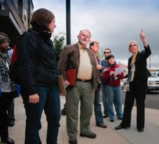
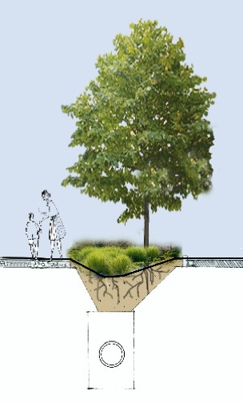

The Sustainable Cities Initiative
Cultivating Sustainable Cities through Applied Research and Education
Our Purpose
To improve the sustainability and livability of cities.
Our Method
We are transforming the university system of education and service by innovatively focusing university activities and resources on real-world problems.
Our Values
Interdisciplinary, Applied, and Aggressively Collaborative.
Our Tools
Education and Service, Research and Scholarship, Policy Assistance.
The Sustainable Cities Initiative is perhaps the most comprehensive effort by a U.S. university to infuse sustainability into its curricula and community outreach.
—Michael Burnham, Greenwire. August 23, 2010
Notes:
Education & Service: The Sustainable City Year program points 100,000 hours by over 500 students in 28 classes with 25 faculty in 10 departments and programs at 16 projects in 1 partner city.
Experts in Residence: SCI brings in experts to meet with students, faculty, Oregon cities, and other academic institutions to forward the thinking around urgent sustainability topics.
Collaborative Research: SCI brings together researchers from different disciplines to address the needs of cities.
Policy Assistance: SCI engages in the policy making process at all levels of government to positively impact the way cities evolve.
The Future of SCI: SCY Expansion, SCI Asia, SCI Summer Institute

Slide 3
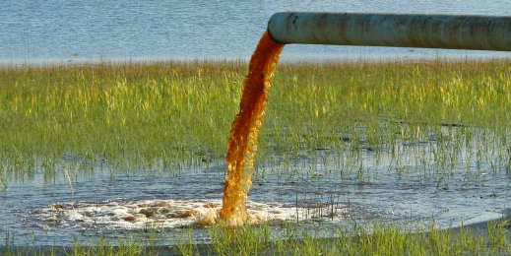
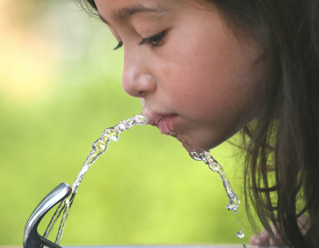

Single Bottom Line?
Triple Bottom Line
Profit
People
Planet
Notes:
Photo source: http://www.thewaterq.com/wnews1/index.php?option=com_content&view=article&id=341:statutory-law-of-water-pollution&catid=89:usa-water&Itemid=463
Alternate photo source: http://geographyblog.eu/wp/water-pollution-and-drought-threaten-worlds-poor-un/
Alternative photo source: http://www.kidzworld.com/article/27529-air-and-water-pollution
Credit: Peter Essick (?)
Photo source: http://www.waterbirdwtc.com/newsread.asp?id=29
Photo source: http://www.livinginperfectharmony.com/880/healthy-living/viewing-your-home-through-the-lens-of-a-camera/
Credit: Susan Muehl

Slide 4
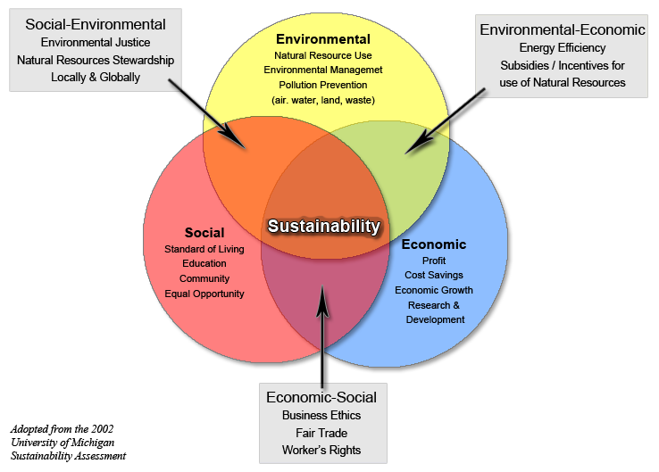
The Three Spheres of Sustainability
Source: Vanderbilt University
Notes:
Three P’s: Profit, People, Planet
Three E’s: Economy, (Social) Equity, Environment
Photo source: http://www.vanderbilt.edu/sustainvu/who-we-are/what-is-sustainability/

Slide 5
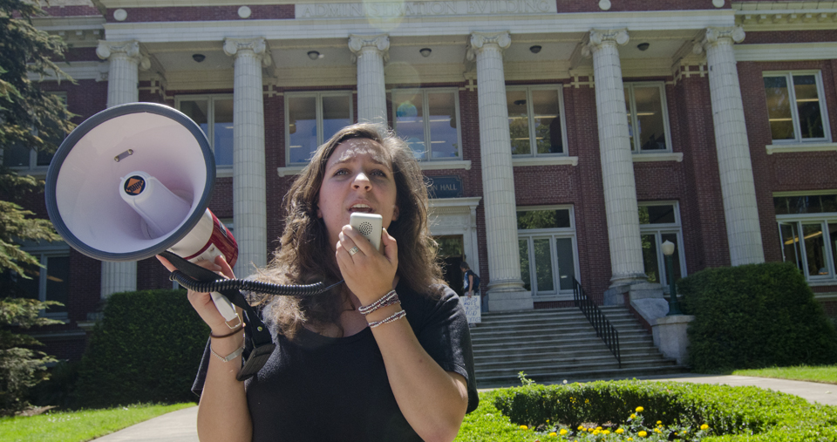
Misunderstood Decisions?
Source: Daily Emerald
Notes:
Photo source: http://dailyemerald.com/2012/06/06/students-secure-meeting-to-discuss-tuition-and-other-issues-with-university-president-robert-berdahl/

Slide 6
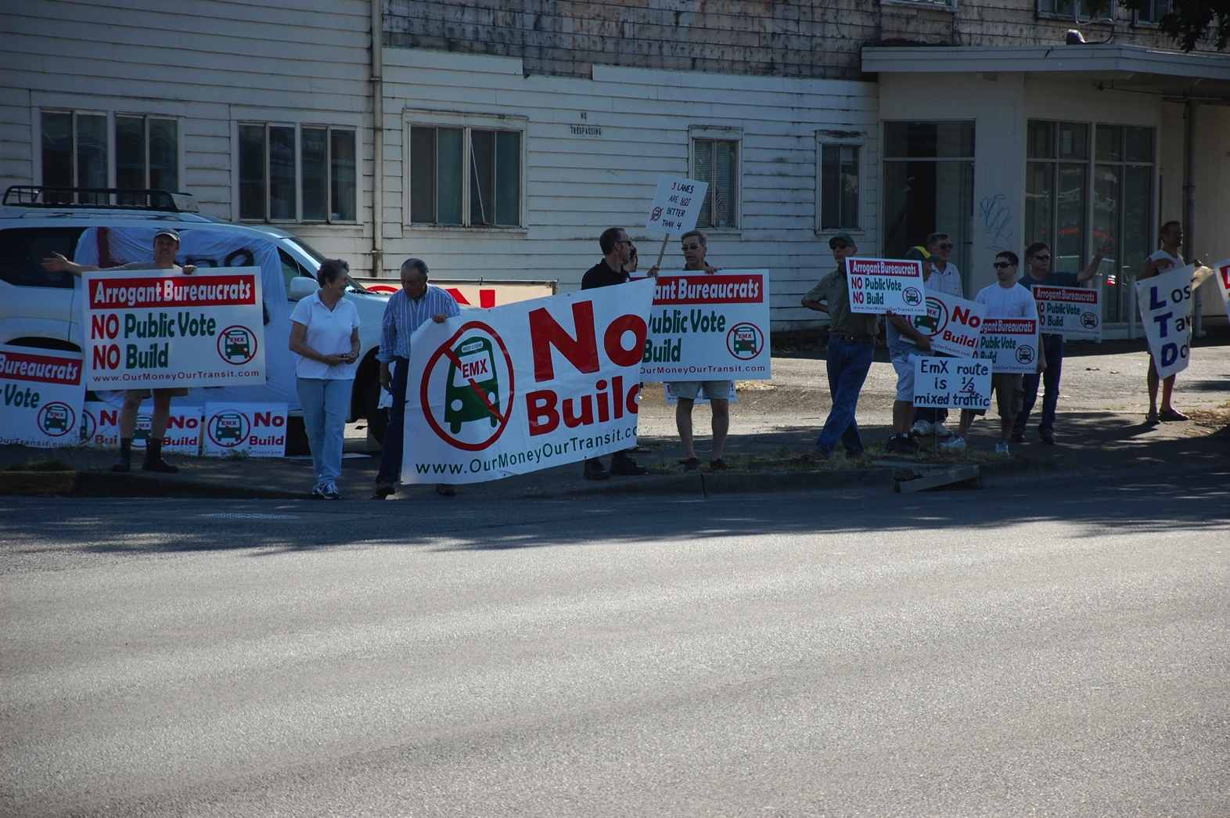
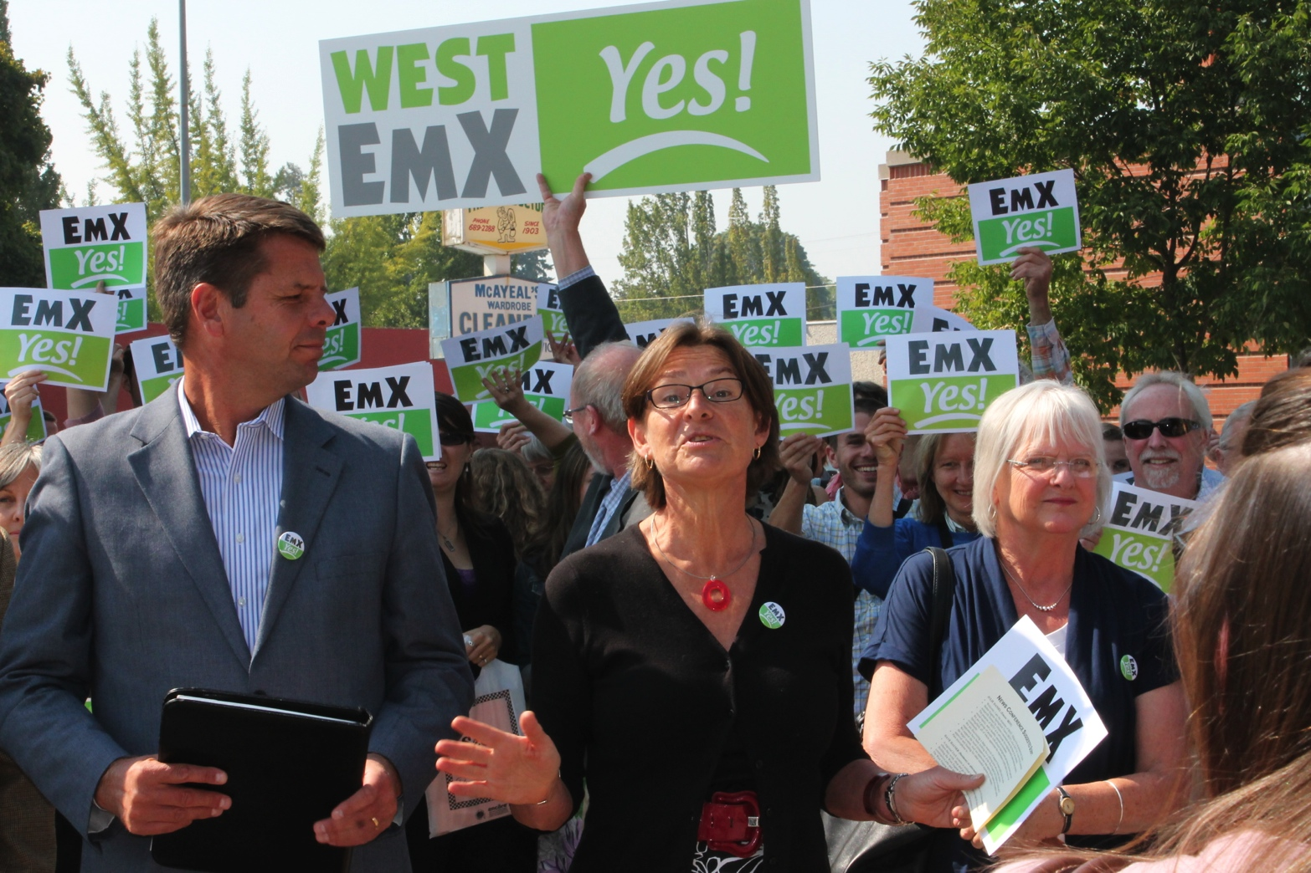
Case Study: West Eugene EmX
No Build
Losing Tax Dollars
Arrogant Bureaucrats
Prosperity
Social Equity
Healthy Natural Environment
Our Money Our Transit (OMOT)
Better Eugene-Springfield Transit (BEST)

Slide 7
Some of Your Recent Decisions?
________________________________________
________________________________________
________________________________________
________________________________________
________________________________________

Slide 8
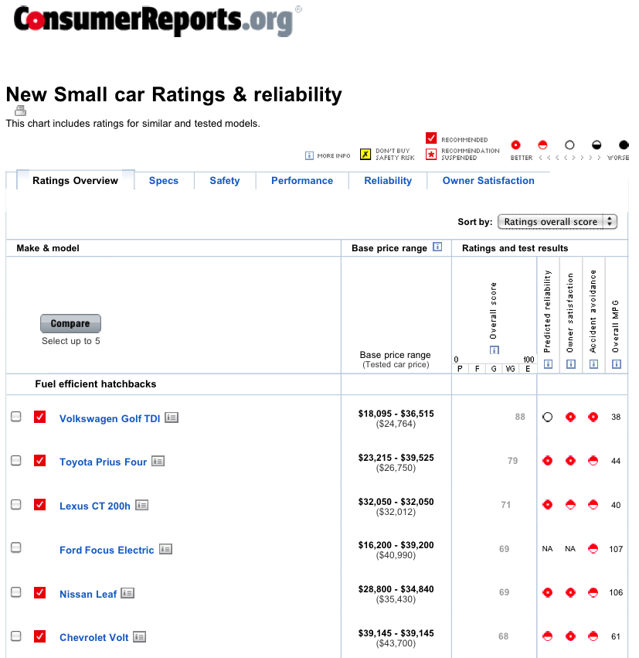
Case Study: Couple Buying a Car

Slide 9
Couple Buying a Car (cont.)
Less or More Fuel Efficient?
 | Model A | Model B
Sticker Price | — | + $6,000
Fuel Efficiency | 25 mpg | 40 mpg
Annual Fuel Costs | $1,600 | $1,000
Sunroof?
 | Basic | w/ Sunroof
Sticker Price | — | + $1,000
Price per Use | — | $4
Notes:
There is no single “right” choice.
Different decision-makers have different priorities.
The recommendations of an outside authority, while suggestive, don’t always match the specific values of the decision-makers.
Although there may be dozens or even hundreds of criteria to consider, in the end just a handful are significant enough to sway the decision one way or the other.
Some costs and benefits can be quantified, even monetized, to help make a decision.
Converting costs and benefits into tangible and comparable units helps makes it easier to evaluate their relative importance.
Other costs and benefits are less tangible, but can be evaluated in terms of opportunities costs: What might be done instead?
Focusing on the key tradeoffs helps decision-makers reach agreement.
Reaching a decision sometimes involves give and take.

Slide 10
Couple Buying a Car (cont.)
Takeaways:
No single “right” choice.
Different decision-makers have different priorities.
Outside authority does always match values of the decision-makers.
Typically, just a few criteria swing the decision.
When possible, monetize or quantify impacts.
Convert impacts into tangible and comparable units.
Look at opportunities costs: What might be done instead?
Reaching a decision sometimes involves give and take.

Slide 11
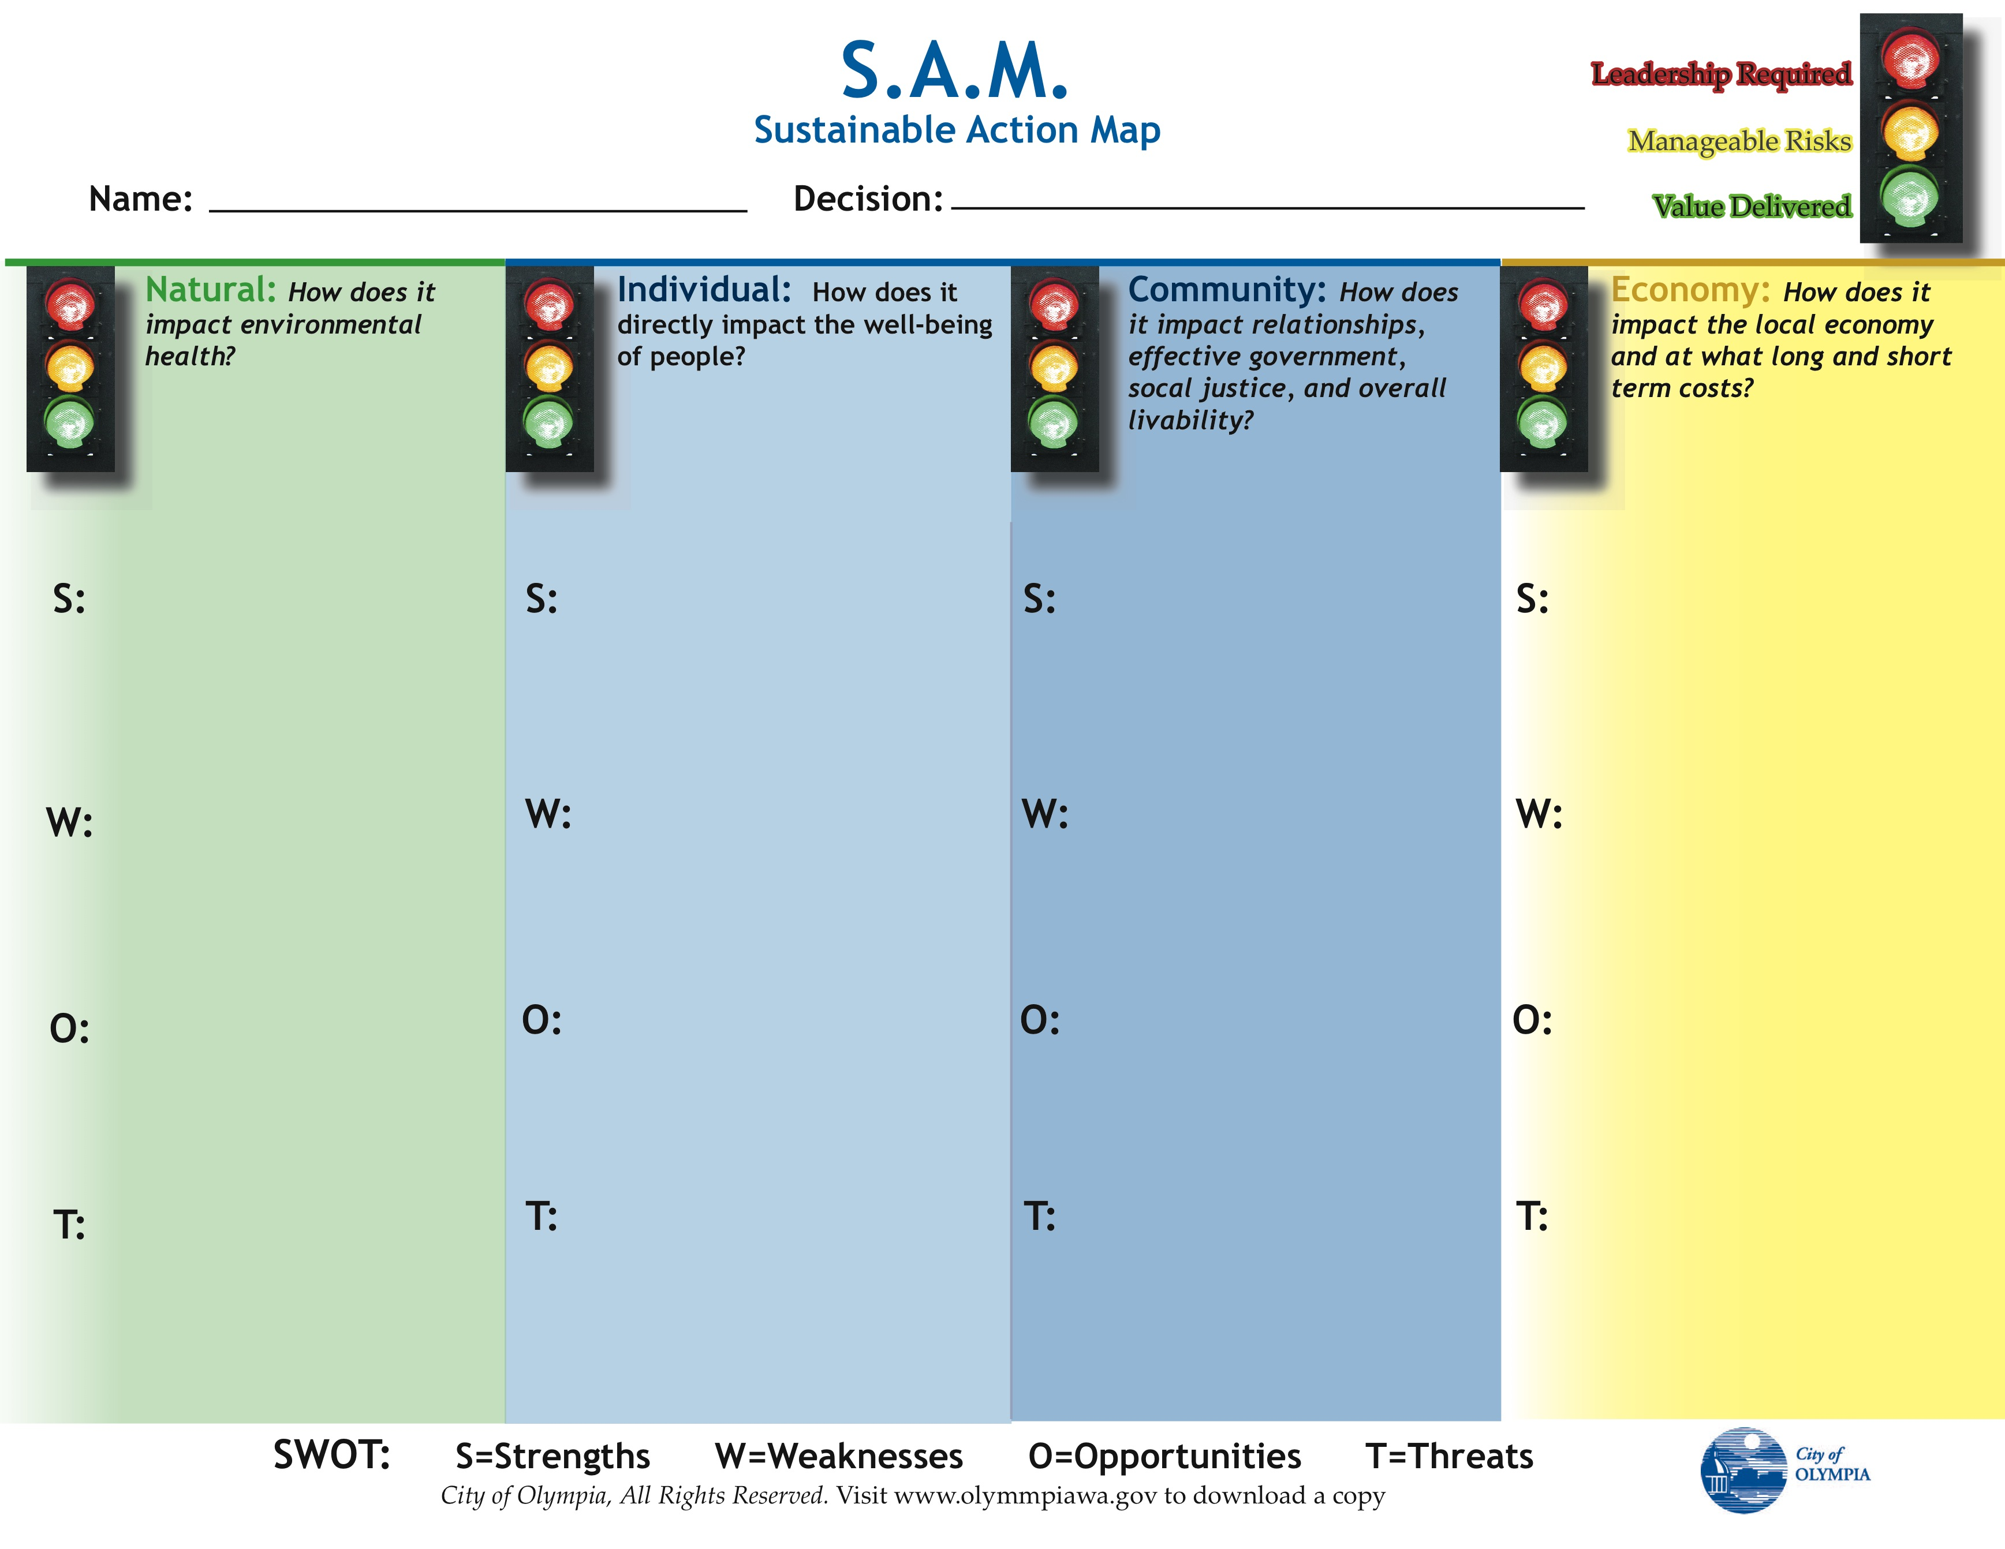
TBL Frameworks
Source: City of Olympia, Washington
Notes:
Source: http://olympiawa.gov/community/sustainability/~/media/Files/PublicWorks/Sustainability/SAM2.ashx

Slide 12
TBL Frameworks (cont.)
Source: City of Olympia, Washington
Notes:
Source: http://olympiawa.gov/~/media/Files/PublicWorks/Sustainability/SAM-Parking-Fines.ashx

Slide 13
TBL Frameworks (cont.)
Source: City of Olympia, Washington
Notes:
Source: http://olympiawa.gov/~/media/7FFFF33312D546B2A045EF67AA7578FA.ashx

Slide 14
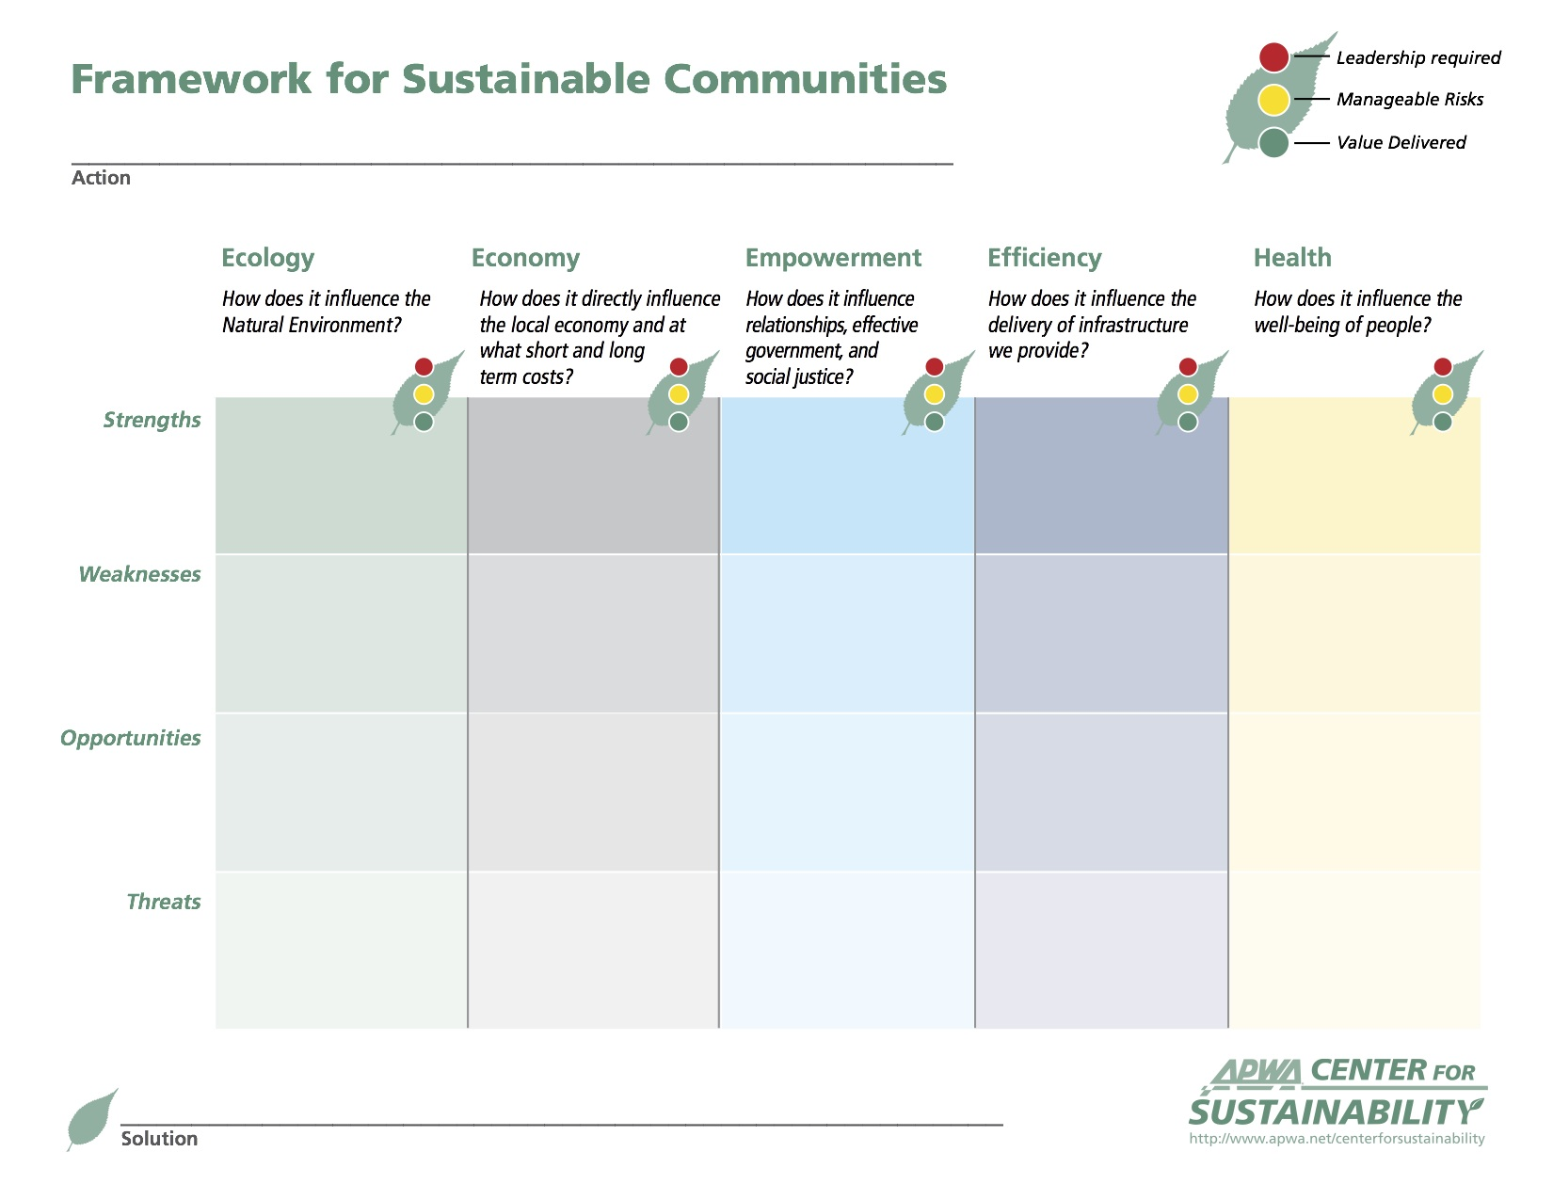
TBL Frameworks (cont.)
Source: American Public Works Association (APWA) Center for Sustainability
Notes:
Source: http://www.apwa.net/centerforsustainability/Process/-Framework-for-Sustainable-Communities

Slide 15
TBL Frameworks (cont.)
Step 1: Identifying. Clearly identify the action.
Step 2: Brainstorming. Complete the framework on the form (get as many ideas as possible).
Step 3: Distilling. Refine your brainstorming list to key issues.
Step 4: Evaluating. Determine how balanced your solution is.
Step 5: Problem Solving. Find a balanced solution (all Need categories have a green or yellow rating).
Step 6: Move Forward. Confirm or assign someone to be responsible for carrying the action forward.
Source: APWA “Framework for Sustainable Communities.” See also APWA “Facilitator’s Guide.”

Slide 16

TBL Tools
Source: Portland State University

Slide 17
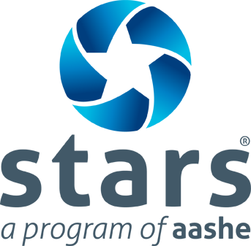
TBL Tools (cont.)
Source: Association for the Advancement of Sustainability in Higher Education (AASHE)
Notes:
Image source: http://www.bu.edu/sustainability/files/2011/11/stars.aashe_1.png

Slide 18
Getting Started with TBL
Special-Purpose Tool: See if an existing special-purpose TBL tool can be applied.
General-Purpose Framework: Otherwise, see if your organization has a general-purpose TBL framework.
Basic Framework: Otherwise, start with (and refine) a basic TBL framework:
  City of Olympia’s Sustainable Action Map (SAM), or
  APWA’s Framework for Sustainable Communities.

Slide 19
TBL Resources
ICLEI: Local Governments for Sustainability. Presentation on sustainability. actrees.org/files/Research/sgrowth137c.pdf
City of Olympia, WA. Sustainable Action Map (SAM). olympiawa.gov/community/sustainability/~/media/Files/PublicWorks/Sustainability/SAM2.ashx
  Buckler, Amy. “Red light, green light: Decision making with SAM, the Sustainable Action Map.” CitiesGoGreen, October 2008. www.nxtbook.com/nxtbooks/verde/citiesgogreen_200810/index.php?startid=10
  Couch, Julianne. “Leading change toward sustainability: Learning from one leader’s successes and failures.” Sustainable City Network, Oct.17, 2012. www.sustainablecitynetwork.com/topic_channels/policy/article_15b7cf6c-1891-11e2-9f6f-001a4bcf6878.html
  Mucha, Michael. “Using the Sustainable Action Map.” Presentation at the 4th Annual Growing Sustainable Communities Conference, Dubuque, IA, Oct. 12, 2011. www.gscdubuque.com/Presentations/SustainableActionMap_2011GSCC.pdf
American Public Works Association (APWA). Framework for Sustainable Communities. www.apwa.net/centerforsustainability/Process/-Framework-for-Sustainable-Communities
City of Eugene, OR. Triple Bottom Line. www.eugene-or.gov/index.aspx?NID=512
Association for the Advancement of Sustainability in Higher Education (AASHE).
  Sustainability Tracking, Assessment & Rating System™ (STARS). stars.aashe.org
  Campus Sustainability Assessment Tools. www.aashe.org/resources/campus-sustainability-assessment-tools
  Resources on Campus Sustainability Coordination & Planning. www.aashe.org/resources/resources-sustainability-coordination-planning
  Campus Sustainability Case Studies. www.aashe.org/resources/case-studies/keyword/162
Portland State University. The Triple Bottom Line Tool. www.tbltool.org

Slide 20
Questions?
Excellence is never an accident. It is always the result of high intention, sincere effort, and intelligent execution; it represents the wise choice of many alternatives—choice, not chance, determines your destiny.
—Aristotle, 350 BCE

